Slide 1

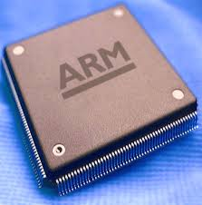
Microprocessors & Computer Architecture UE18CS253
UNIT-1
Session – 9 and 10
Instruction Encoding
Credits:
MPCA Team
SESSION JAN-MAY 2020
1
Notes:
1

Slide 2
THE ARM
Instruction Encoding
SESSION JAN-MAY 2020
2

Slide 3
Instruction Encoding
Some queries……
What is Instruction Encoding?
Is it required?
Who does….?
When is it done…?
SESSION JAN-MAY 2020
3
Notes:
10-Jan-20
3

Slide 4
Instruction Encoding – An Introduction
Any processor uses the concept of a stored program.
Instructions that comprise the program is required to execute are represented using binary numbers and are stored inside the memory.
So, inside a computer, instructions as expected are also represented using a collection of bits/ bit pattern.
How does the CPU know if something is an instruction or not?
It does not.
Any memory location may potentially contain data or instructions.
What differentiates the two is not to be found in memory itself.
The only thing that differentiates an instruction from data is the point in time the CPU references it.
Recall that a CPU goes through the following steps repeatedly
SESSION JAN-MAY 2020
4

Slide 5
Instruction Encoding – An Introduction
Fetch the instruction from memory. FETCH
Decode the instruction in the processor. DECODE
Execute the instruction. Execute
Write the data in the memory location. Buffer / Data
Write the data in the processor register. Write Back
SESSION JAN-MAY 2020
5

Slide 6
Instruction Encoding – An Introduction
The next question is “what is contained in the instruction?”.
The instruction is an encoding that uniquely represents all the information necessary to perform each one of the steps of instruction in detail.
Here are examples of what needs to be represented by an instruction:
The operation that must be performed OPCODE, Ex. ADD, B, BL.
The source operands and destination operand. Ex. GPRegisters R0 and if necessary values Ex. Immediate Data, #35
Updating PC.
Note: This information may be represented implicitly.
Ex. All non-control-flow instructions do not explicitly contain any information on how to update the PC. It is implied that PC ought to become “PC + 4”.
Only control-flow instructions contain explicit information such as the offset to be added to the target to get the address for either in branch or BL instructions.
SESSION JAN-MAY 2020
6

Slide 7
Instruction Encoding – An Introduction
What does the instruction contain ?
An instruction is formed of an opcode and upto three operands.
Machine code or machine language is a set of command words or microinstructions that are executed directly by a computer’s central processing unit (CPU).
Each instruction performs a very specific task, such as a LOAD, a BRANCH, or an ADD/ Sub/CMP operation on a unit of data in a CPU register or memory.
Every instruction directly executed by a CPU is made up of a series of such instructions.
Every program directly that is run by the CPU is made up of a series of such instructions.
This process is also called DISASSEMBLER.
The process of writing the instruction in 0s and 1s is called as hand assembly.
SESSION JAN-MAY 2020
7

Slide 8
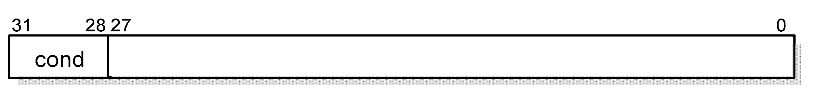
Instruction Encoding: Binary codes for Condition Codes
Fifteen different conditions may be used: these are listed in Condition code summary.
The sixteenth (1111) is reserved, and must not be used.
In the absence of a suffix, the condition field of most instructions is set to "Always" (sufix AL). This means the instruction will always be executed regardless of the CPSR condition codes.
The ARM condition code field
SESSION JAN-MAY 2020
8

Slide 9
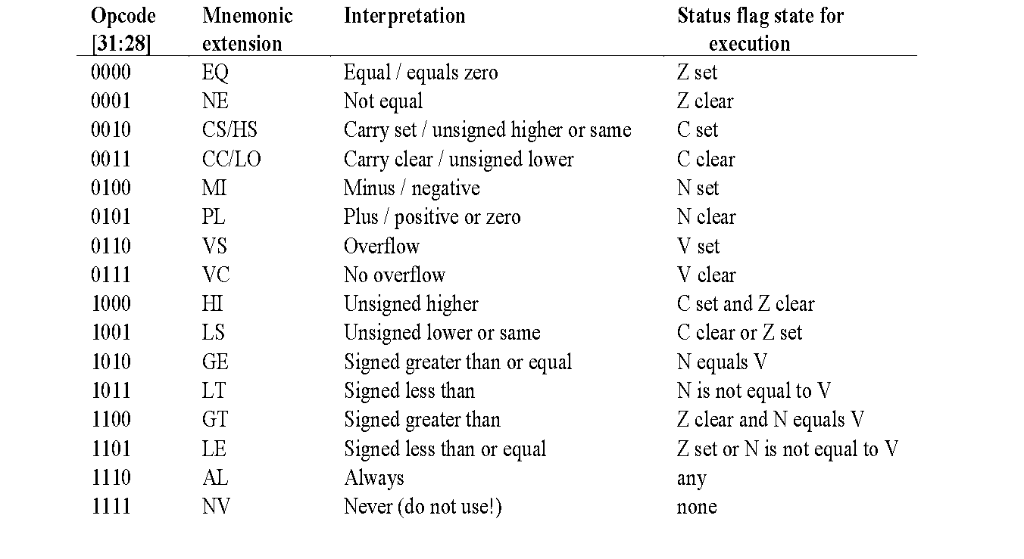
Instruction Encoding – Condition code summary
SESSION JAN-MAY 2020
9

Slide 10
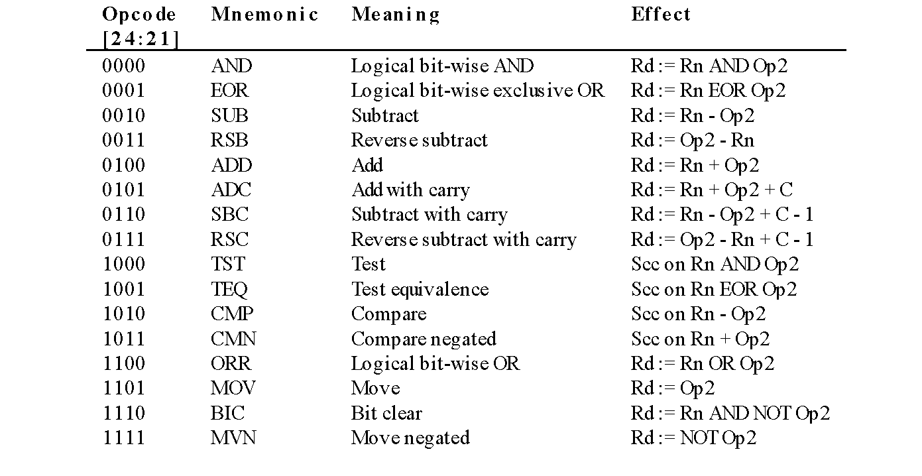
Instruction Encoding: data processing instructions
Machine Code is what computer processors run on: binary representations of simple instructions. All ARM processors (like the one in iPhone, or the other dozen in various devices) have 16 basic data processing instructions.
SESSION JAN-MAY 2020
10

Slide 11
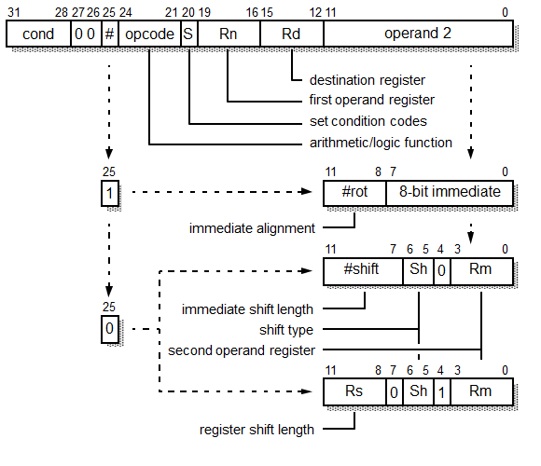
binary encoding- Data processing instruction
SESSION JAN-MAY 2020
11

Slide 12
binary encoding- Data processing instruction
Each data processing instruction can work with several combinations of operands.
Ex 1. ADD R0, R1, R2 ; R0 = R1 + R2
Ex 2. ADD R0, R1, R2, LSL #2 ; R0 = R1 + R2 << 2
Ex 3. ADD RO, R1, #5 ; R0 = R1 + 5
SESSION JAN-MAY 2020
12

Slide 13
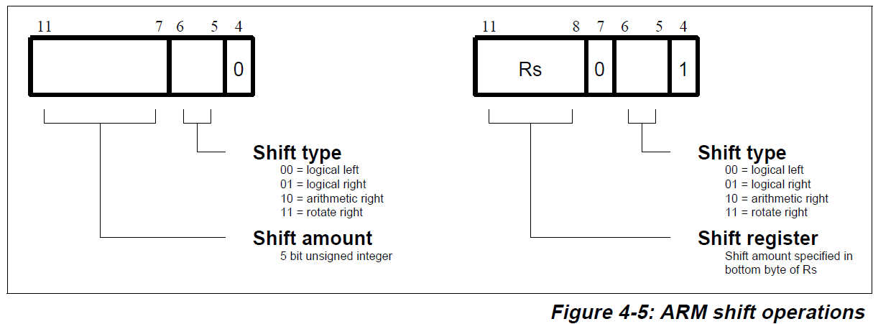
Instruction Encoding: data processing instructions
SESSION JAN-MAY 2020
13

Slide 14
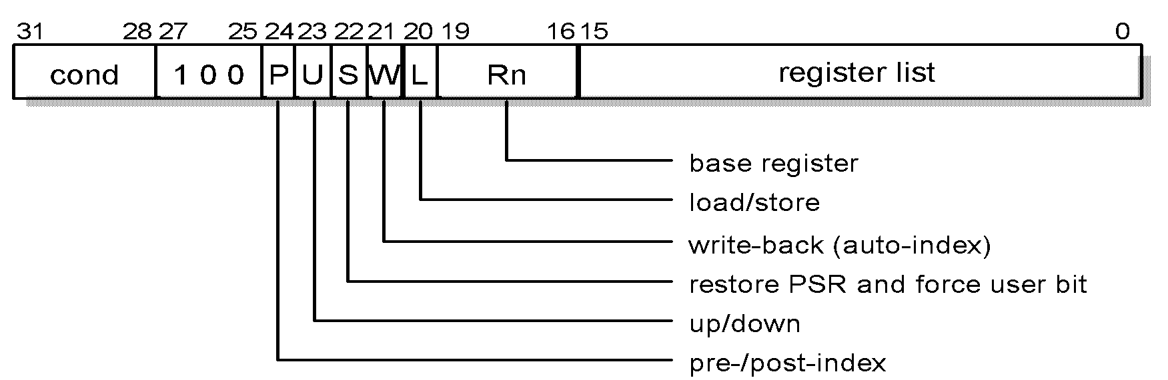
binary encoding - multiple register data transfer instruction
Ex 1: LDMIA R13! , { R0, R5 - R8, R11}
Ex 2: STMIA R13! , { R8, R4- R6, R12}
SESSION JAN-MAY 2020
14

Slide 15
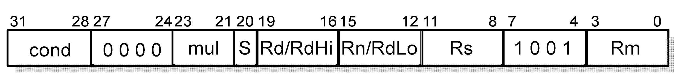
Instruction Encoding – Multiplication instructions
Ex 1: MUL R0, R1, R2
Ex 2: MLA R0, R1, R2 , R3
Ex 3: SMULL R0, R1, R2 , R3
Ex 4: UMLAL R0, R1, R2 , R3
SESSION JAN-MAY 2020
15

Slide 16
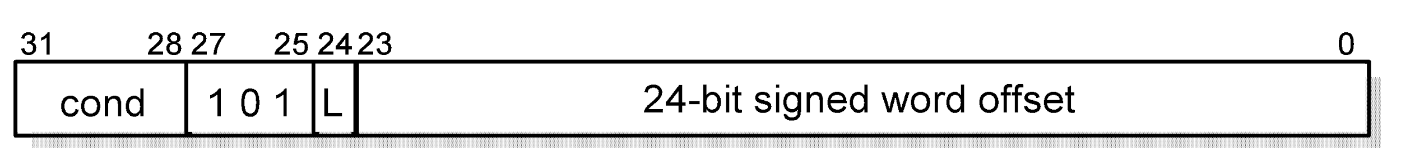
Instruction Encoding: Branch instructions
Ex 1: B LOOP
Ex 2: BL SUBROUTINE
SESSION JAN-MAY 2020
16

Slide 17
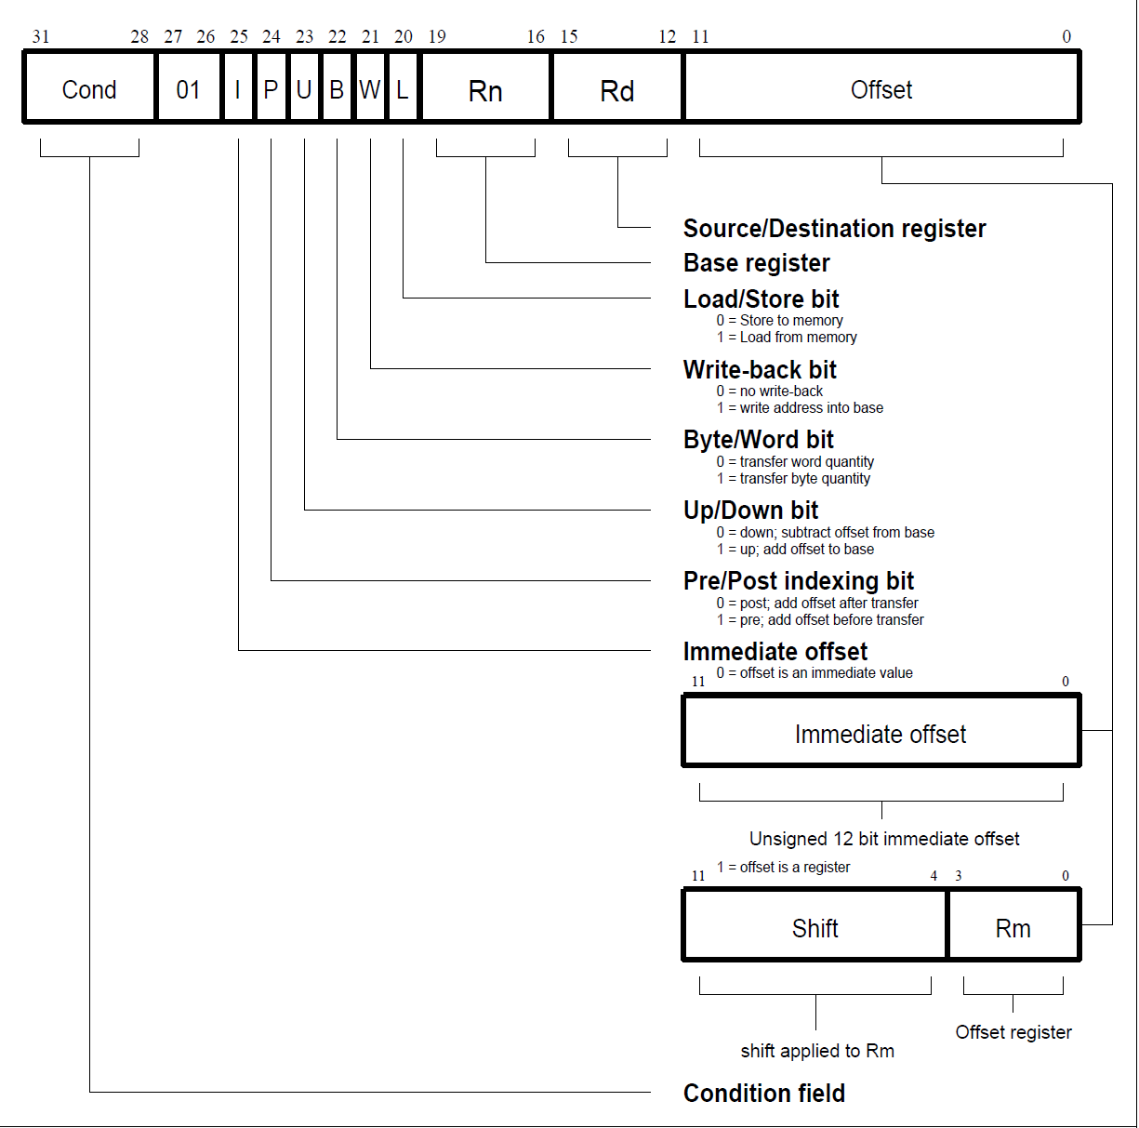
Instruction Encoding – Load / Store instructions
SESSION JAN-MAY 2020
17

Slide 18
Q & A
on
Instruction Encoding
SESSION JAN-MAY 2020
18

